Slide 1
Fiat-Shamir for Highly Sound Protocols is Instantiable
Arno Mittelbach
Daniele Venturi
Security and Cryptography for Networks – SCN 2016
Amalfi, 01/09/2016
Notes:
Say we could not attend the conference

Slide 2
Sigma Protocols
$$(x,w)∈R$$
$$α$$
$$x$$
NP Relation
$$β$$
$$γ$$
Prover
Verifier
Completeness: Honest prover (almost) always convinces verifier
Soundness: Malicious prover can’t prove false statements $x∉L$
HVZK: There exists efficient simulator that given $x$ produces triplets $\left(α,β,γ\right)$ with the same distribution as honest protocol transcripts with $\left(x,w\right)∈R$

Slide 3
Fiat-Shamir Transform
$$(x,w)∈R$$
$$x$$
$$π=(α,γ)$$
$$β=H(α)$$
Prover
Verifier
The verifier accepts as long as $(α,β,γ)$ is valid for $β=H(α)$
Theorem [FS89,…]: If 𝛴 is a Sigma protocol and H is modelled as a RO, the FS transform yields a NIZK

Slide 4
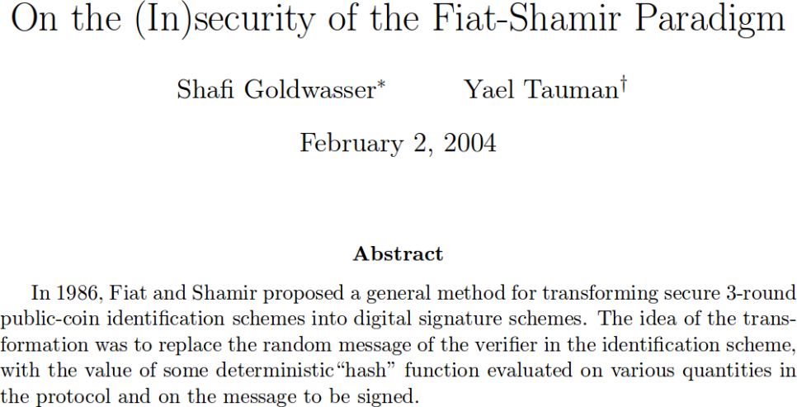
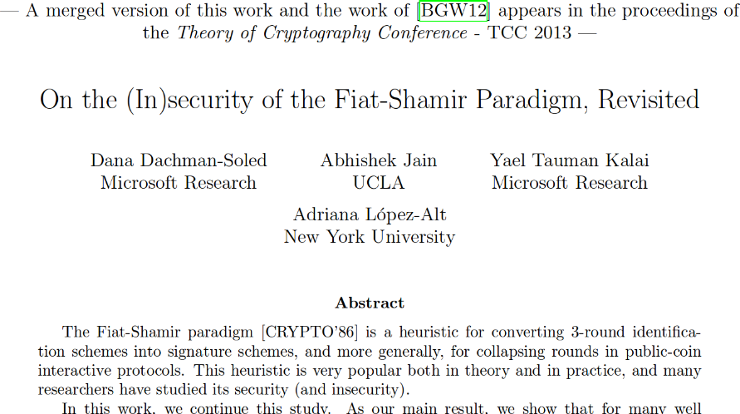
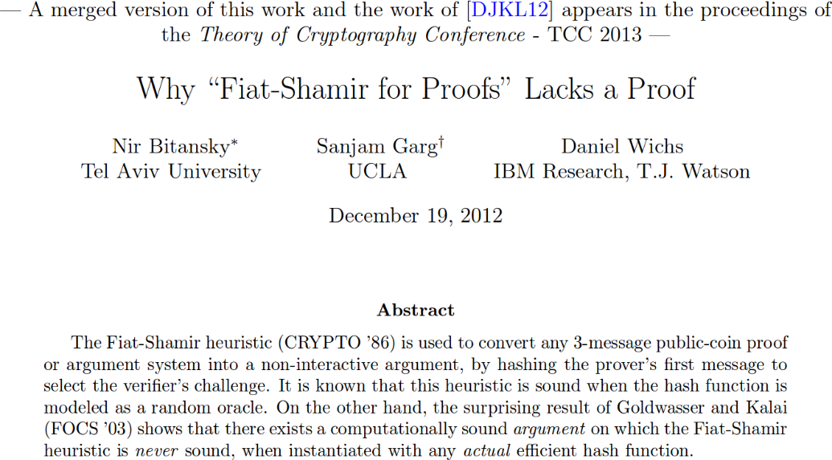
Negative Results
Fundamental Question: Prove restricted standard-model results for FS

Slide 5
Our Work & Talk Outline
Identify a class of so-called highly sound protocols admitting a simple information-theoretic instantiation of FS
These are special Sigma protocols satisfying three requirements P1, P2, P3
General-purpose compilers in the CRS model
First compiler: Takes any 𝛴 with P1, P3 and outputs $Σ′$ with P1, P2, P3
Second compiler: Takes any 𝛴 with P1 and outputs $Σ′$ with P1, P3
Ingredients: iO, puncturable PRFs, equivocable commitments
Many natural protocols already meet P1, and protocols meeting P1 and P3 exist for all of $NP$ assuming one-way permutations [LS91,OV12]

Slide 6
Standard Model Instantiation
$$H\left(∙\right)=hk$$
$$(x,w)∈R$$
$$x$$
$$π=(α,γ)$$
$$β=H\left(α\right)=hk$$
Prover
Verifier
We show that under certain properties the above preserves soundness and suffices for one-time zero-knowledge
Can be generalized to $q$-bounded zero-knowledge using $q$-wise independent hashing

Slide 7
The Selective FS Transform
$$(x,w)∈R$$
$$α$$
$$x$$
$$hk$$
$$β=H\left(α\right)=hk$$
$$γ$$
Prover
Verifier
Theorem: If 𝛴 is complete and sound, so is its Selective FS transform with the constant hash function
Notes:
Explain that the constant hash function is programmable

Slide 8
Intuition for Soundness Proof
$$H\left(∙\right)=hk$$
Hope $α=α^{∗}$
$$α$$
$$π=(α^{∗},γ^{∗})$$
$$hk$$
$$γ^{∗}$$
$$x$$
$$x$$
$$x$$
FS Collapse Adversary
Selective FS Adversary
Verifier
P2: Ratio is bounded away from one
Soundness = $\frac{Selective FS Soundness}{\max{probability of guessing α^{∗}}}$

Slide 9
Intuition for (One-Time) Zero Knowledge
$$crs=hk$$
$$(α,β)$$
P3: Can be computed indep. of $x$
HVZK Simulator
$$(x,w)∈R$$
$$tk=r$$
$$π=(α,γ)$$
$$x$$
$$π=(α,γ)$$
P1: Can be computed indep. of $x,w$
$$x$$
Prover
Verifier
NIZK Simulator
$$(α,γ)$$
HVZK Simulator
Essentially we do the programming up-front relying on P1 and P3
Notes:
Instead in the ROM proof the programming is done adaptively by programming the random oracle

Slide 10
Highly Sound Protocols and Main Theorem
3-move protocols with completeness, soundness, HVZK and
P1: Commitment 𝛼 can be computed independently of $x,w$
P2: Soundness-error-to-guessing ratio (SEGR) bounded away from one
P3: HVZK Simulator computes $(α,β)$ independently of $x$
Main question: Do highly sound protocols exist at all???
Theorem: If 𝛴 is highly sound, then its FS collapse using a $q$-wise independent hash is a $q$-bounded NIZK

Slide 11
Example: Blum’s QR Protocol
Blum Integer $N$
$$(x,w)∈R_{QR}$$
$$α=r^{2}$$
$$β←\{0,1\}$$
$$x=w^{2}mod N$$
$$x$$
$$γ^{2}≟x^{β}∙α$$
$$γ=w^{β}∙r$$
$$r←ℤ_{N}^{∗}$$
Prover
Verifier
P1 clearly met, but P2 and P3 are not
Soundness is only ½
HVZK Simulator computes $α$ depending on $x$
The Lapidot-Shamir protocol for graph hamiltonicity directly meets P1 and P3 [LS91,OV12]

Slide 12
First Compiler
P1+P3
$$iO(F_{1}(k_{1},∙))$$
$$iO(F_{2}(k_{2},∙+i))$$
$$k_{1}$$
$$k_{2}$$
$$α_{1},…,α_{n}$$
$$(x,w)∈R$$
$$α^{∗}$$
Check:$(α_{i},β_{i},γ_{i})$ valid $∀i∈[n]$
$$r^{∗}$$
$$α^{∗}$$
$$β_{1},…,β_{n}$$
$$k_{2}$$
$$α^{∗}$$
$$α_{1},…,α_{n}$$
$$γ_{1},…,γ_{n}$$
$$x$$
Prover
Verifier
P1 and P3 easily seen to be preserved
P2 holds since $n$ is independent of the size of the pre-commitment $α^{∗}$

Slide 13
Second Compiler
P1
Can be perfectly binding or equivocal depending on setup
$$α^{∗}$$
$$(α^{∗},δ)←Com(α)$$
$$β$$
$$(γ,δ)$$
$$(x,w)∈R$$
$$x$$
Prover
Verifier
P1 clearly preserved, completeness and soundness also are preserved (when the commitment is binding)
The HVZK Simulator can commit to arbitrary $α^{∗}$ and later open this to any $α$ (which allows to show P3)

Slide 14
Concluding Remarks
We have shown a restricted positive result on FS without ROs
Highly sound protocols admit simple instantiation of the RO
Highly sound protocols exist for all of $NP$ (under strong assumptions) in the CRS model
Not clear what a positive result for FS in the CRS model means!
Common Reference String $crs$
$$ε$$
NIZK proof of $x∈L$
$$ε$$
$$γ^{∗}$$
$$(x,w)∈R$$
$$x$$
Prover
Verifier

Slide 15
Concluding Remarks
Big open question!
Still our result has some nice features:
It works in the standard model if one can construct a highly sound protocol without relying on a CRS
Our CRS-based compilers make a non-trivial use of the starting Sigma protocol
Extensions and directions for future research:
Similar result works for FS signatures (via highly sound ID schemes)
What about «Strong FS»?
Apply our ideas to other RO-based transforms (e.g., Fischlin’s [Fis05])
Concurrent work by Kalai, Rothblum and Rothblum [KRR16]
Positive result starting with any 3-move public-coin proof (uses similar tools)
Only applies to soundness of the interactive FS collapse (2 rounds)

Slide 16
Thank You!
Full version available as ePrint Report 2016/133
https://eprint.iacr.org/2016/313

